Slide 1
Deep Learning Foundations Advanced Machine Learning
Data Science at Zindua School | By Chris Aloo

Slide 2
Checkpoint
Week 1 Project
Week 2 Project
Week 3 Project
Project ReadMe and Project Review Rubric

Slide 3
Coverage
Intro to Deep Learning Concepts
ANNs - Intuition
Backpropagation
Cross Validation
Regularization : Drop Out and Mini Batches
Meta parameters : Optimizers, Batch Normalization, Activation Functions, Loss Functions
CNN
RNN
Auto Encoders
Bonus : Gen AI foundations and Pre-trained Models

Slide 4
Coverage
Terminologies, Concepts and Topics in Deep Learning
MLP - ANN - Vanilla Neural Network
- Regression
- Classification
- Feature Transformation
CNN
- Image Processing and Predictions
- Captioning
- Image Analysis
RNN - Sequential Models
- LSTM
- GRUs
- Sequential Data - Time Series , Text
Auto Encoders
Transformers
--------------
Nodes/Layers - Input, Output, Hidden
Fully Connected Layer
Backpropagation
Activation Functions
Regularizations : L1 and L2 Regularization, Elastic Net , Dropout, Early Stopping
Epochs
Optimization Functions
Attention
Pooling
Filters and Kernels
--------------
Frameworks
Scikit Learn
TensorFlow - KERAS API
Pytorch - Torch API

Slide 5
Introduction to Deep Learning

Slide 6
Introduction to Deep Learning
Deep Learning Concepts
Limitations of traditional machine learning algorithms
not good at handling high dimensional data.
difficult to do feature extraction and object recognition.
Advantages of deep learning
DL is computationally expensive, but it is capable of handling high dimensional data.
Feature extraction is done automatically.
Artificial Intelligence A program that can sense, reason, act and adapt
Machine Learning Algorithm whose performance improve as they are exposed to more data over time
Deep Learning Subset of machine learning in which multilayer neural networks learns from vast amount of data

Slide 7
History to Deep Learning
1960s: Neural Networks used of binary classification
1970s: Neural Networks popularity dries after not delivering on the hype
1980s: Backpropagation is used to train the deep networks
1990s: Neural Networks take the back seat to support vector machines due to the nice theoretical properties and guarantee bounds
2010s: Access to large dataset and more computation allowed deep networks to return and have state-of-the-art results in the speech, vision and natural language processing.
Why Now : Larger Datasets, Better Hardware, Smarter Algorithms

Slide 8
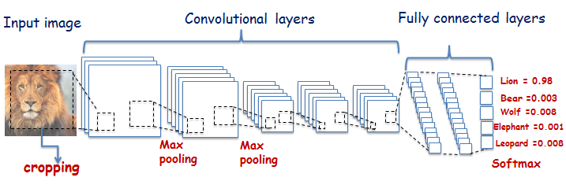
Examples and Uses

Slide 9
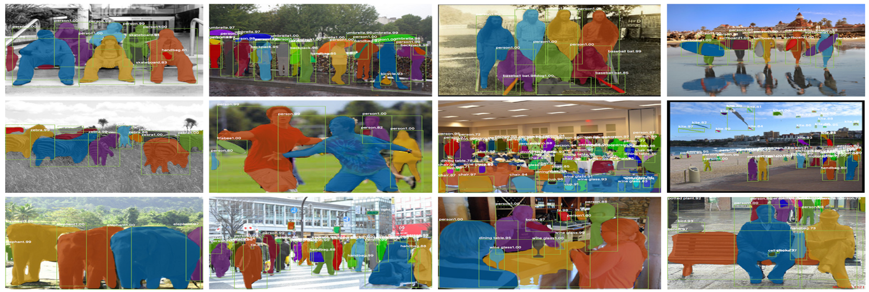
Examples and Uses

Slide 10
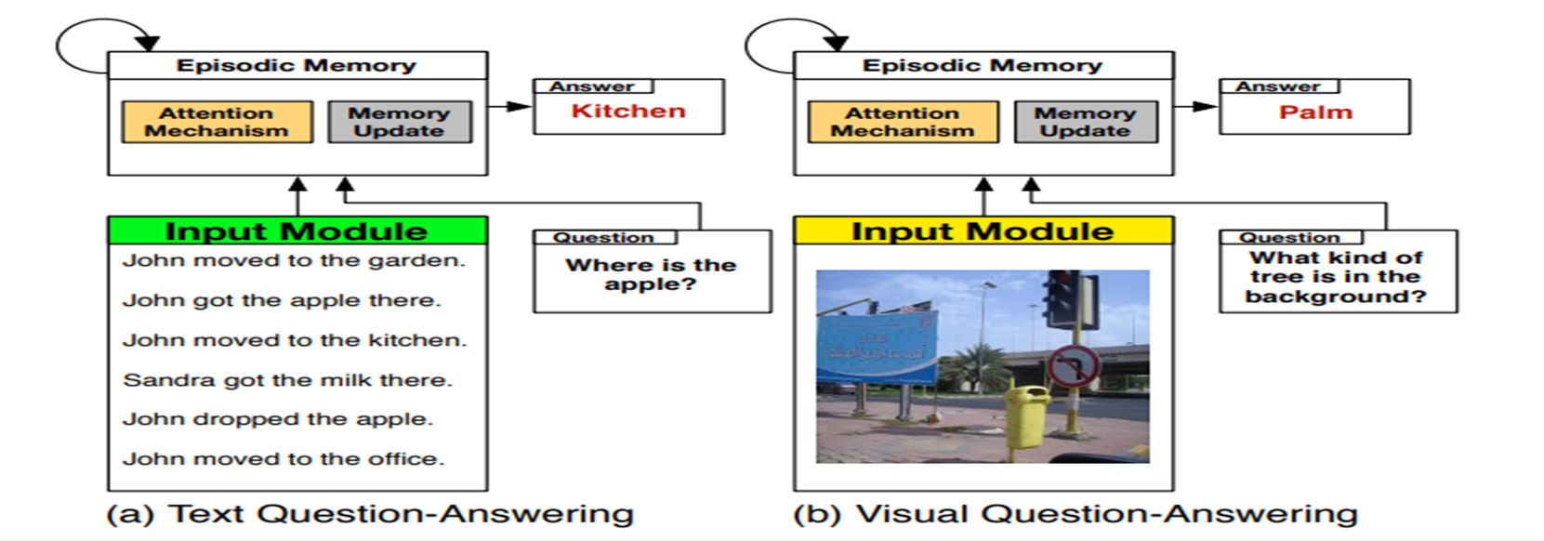
Examples and Uses

Slide 11
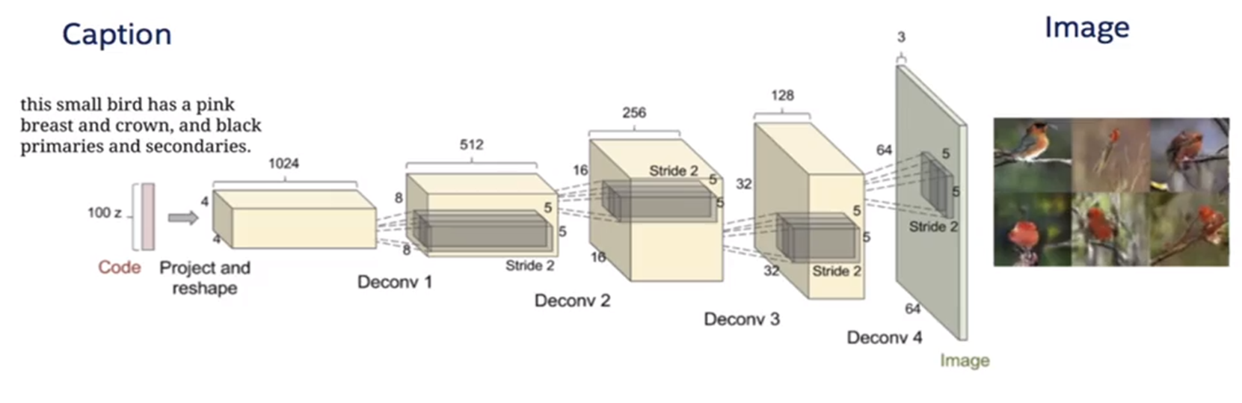
Examples and Uses

Slide 12
ANN’s Intuition

Slide 13
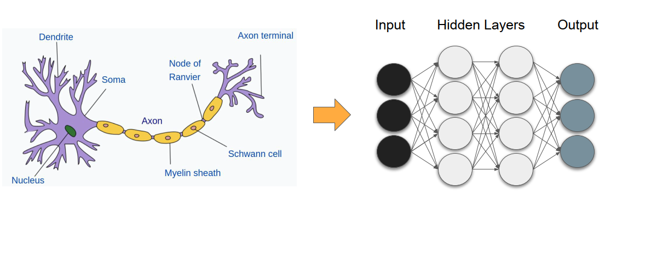
ANN

Slide 14
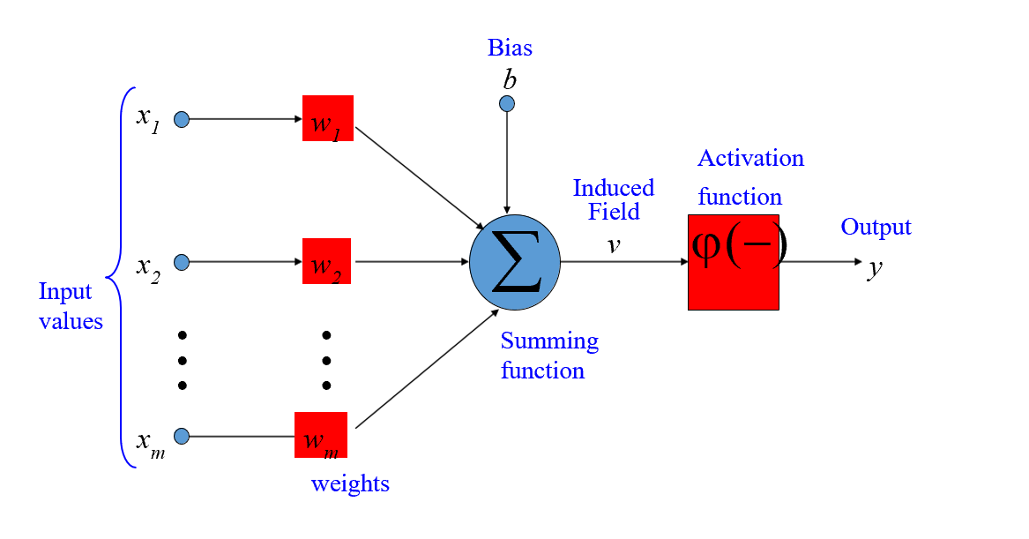
Perceptron

Slide 15
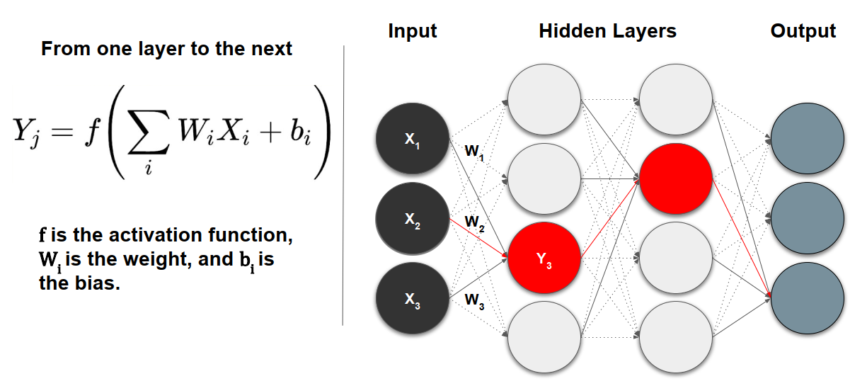
Training with Deep Networks

Slide 16
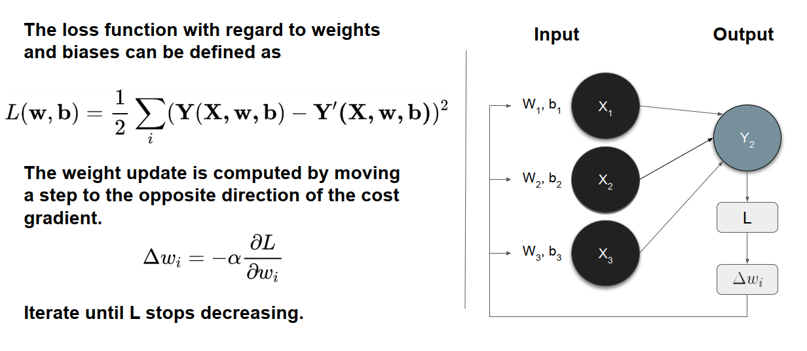
Training - Minimizing the Loss

Slide 17
Activation Functions
SoftMax Activation
Sigmoid
Tanh
ReLu
Elu
Leaky Relu

Slide 18
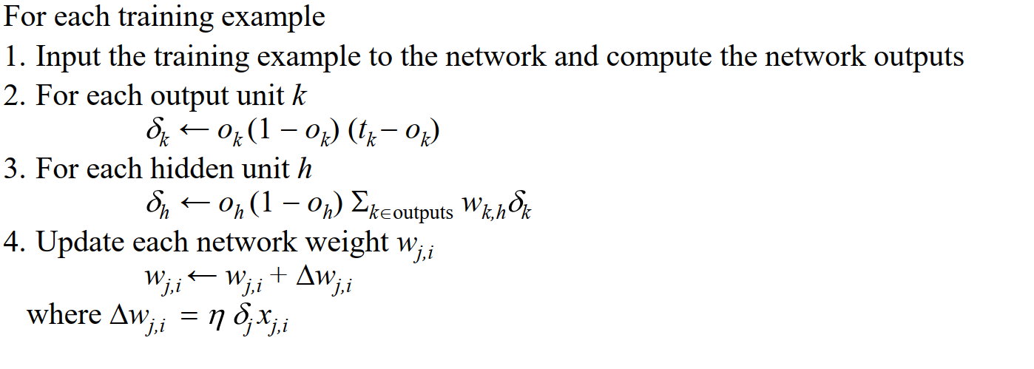
Backpropagation
Initialize all weights to small random numbers
Repeat

Slide 19
CNNs

Slide 20
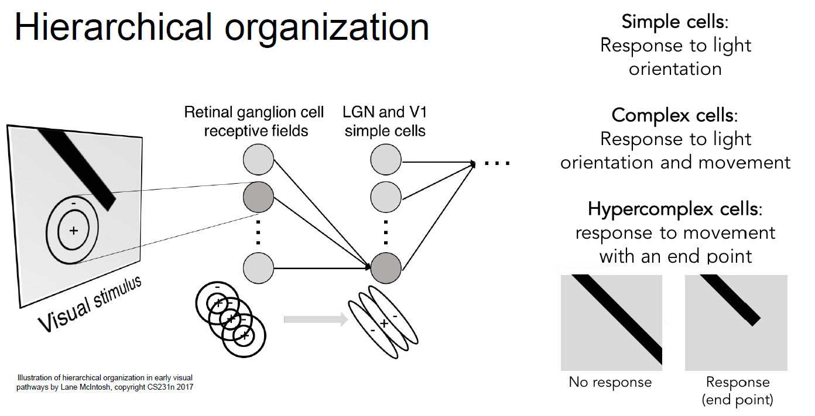
Convolutional Neural Network: Motivation

Slide 21
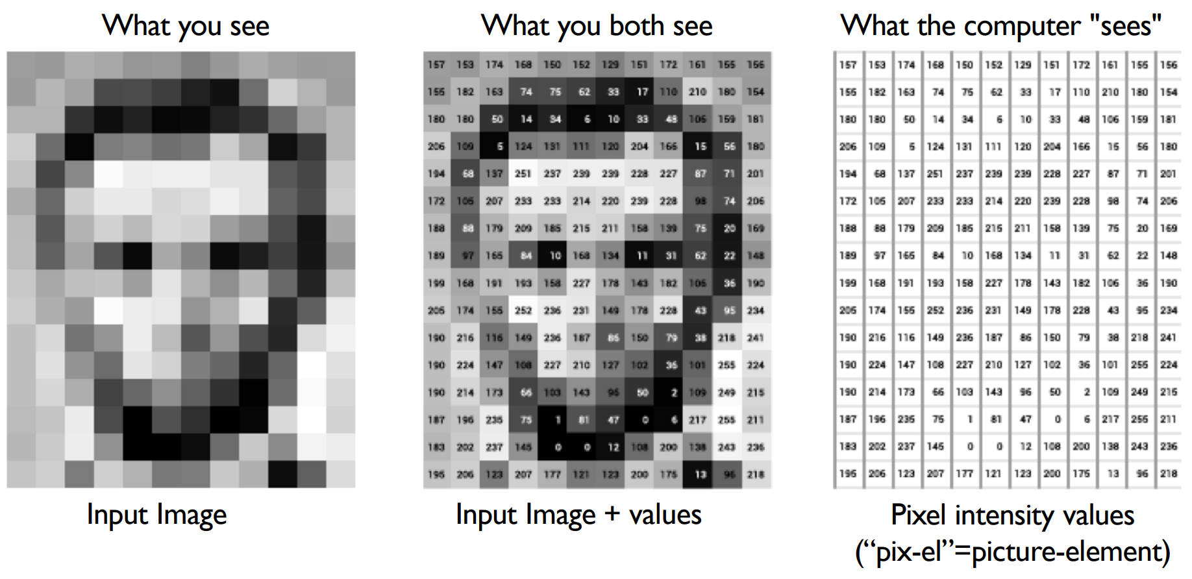

Slide 22
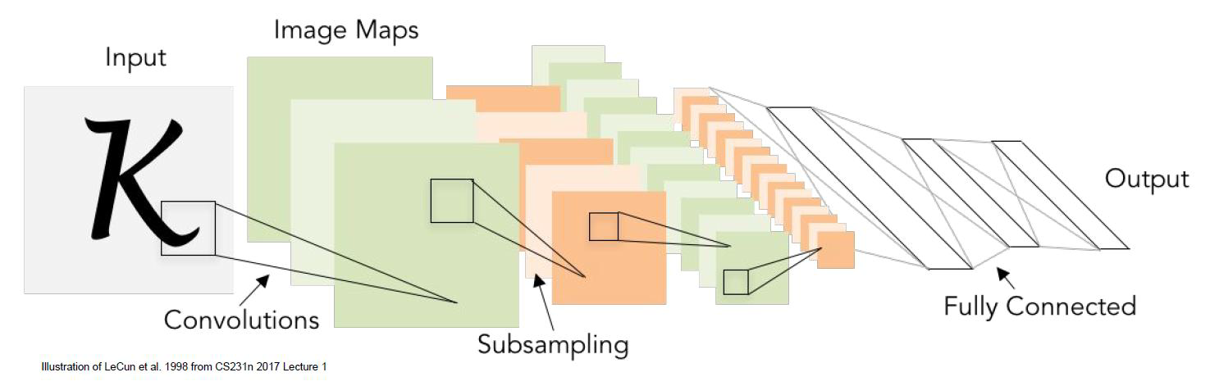
CNN

Slide 23
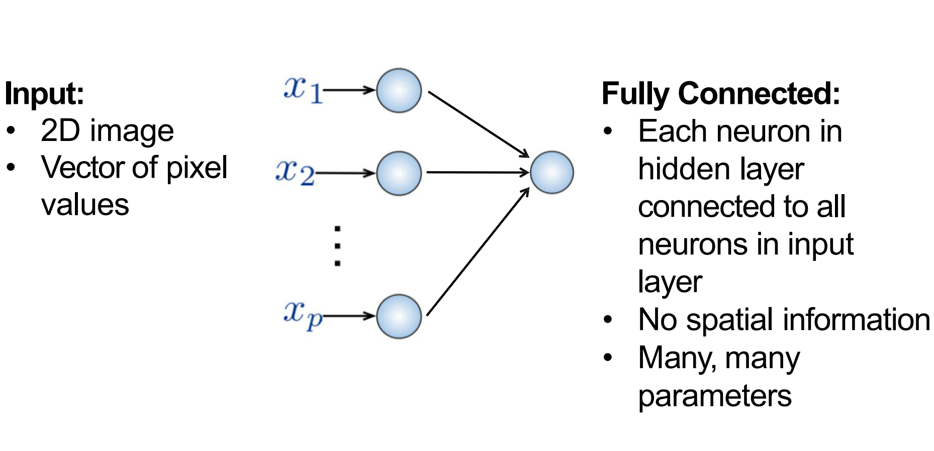
Fully Connected Layer

Slide 24
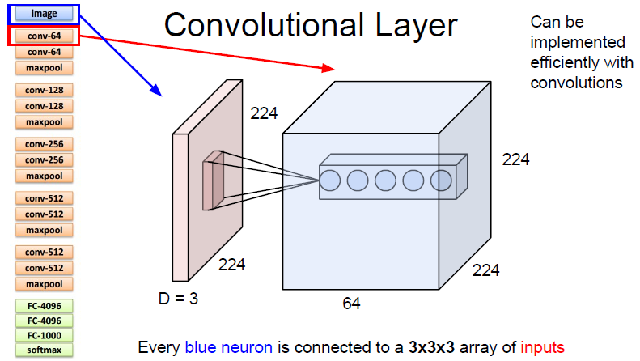

Slide 25
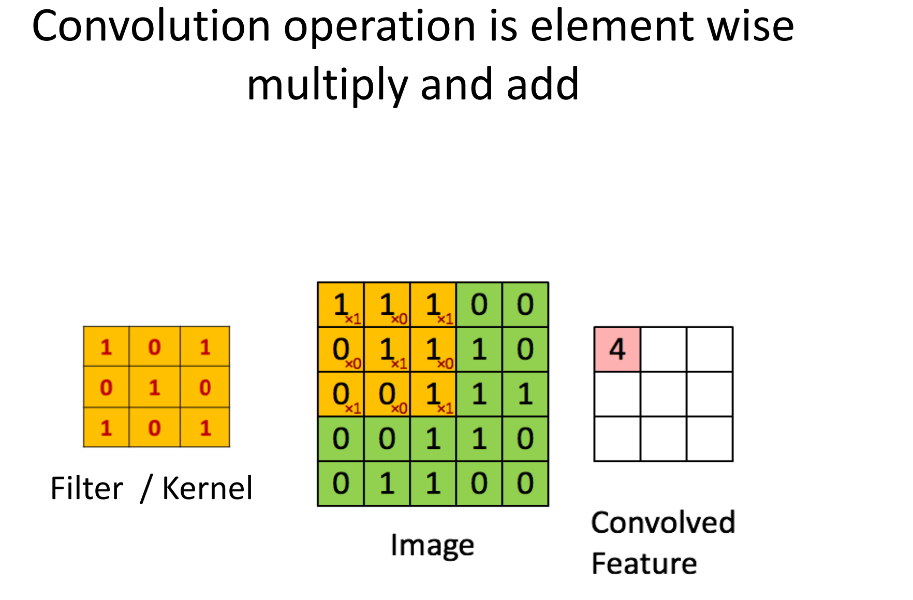

Slide 26
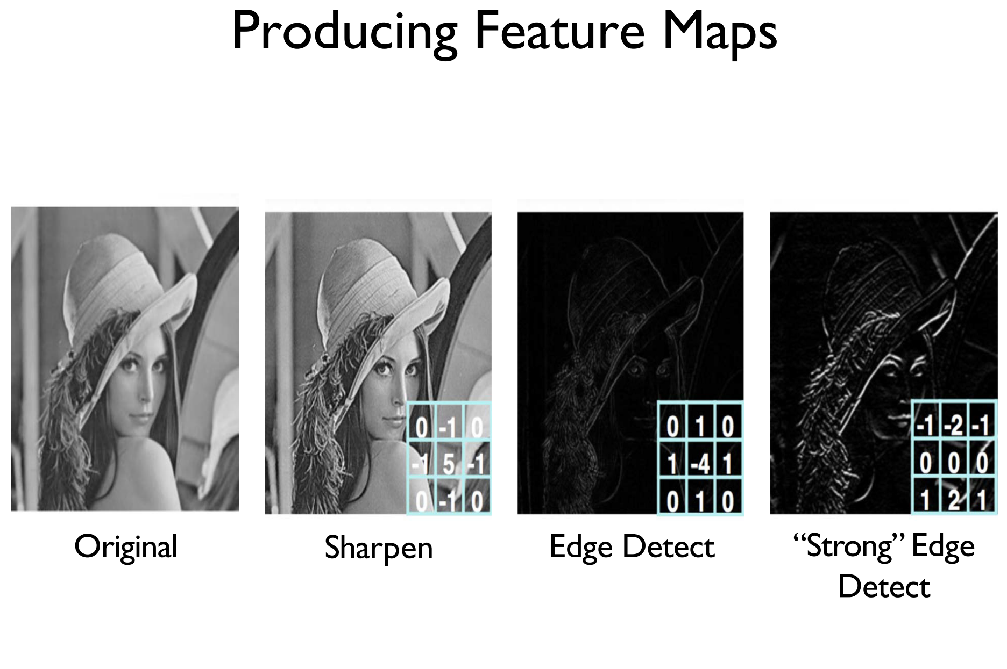
I would want to see the logic for the body calculations.

Slide 27
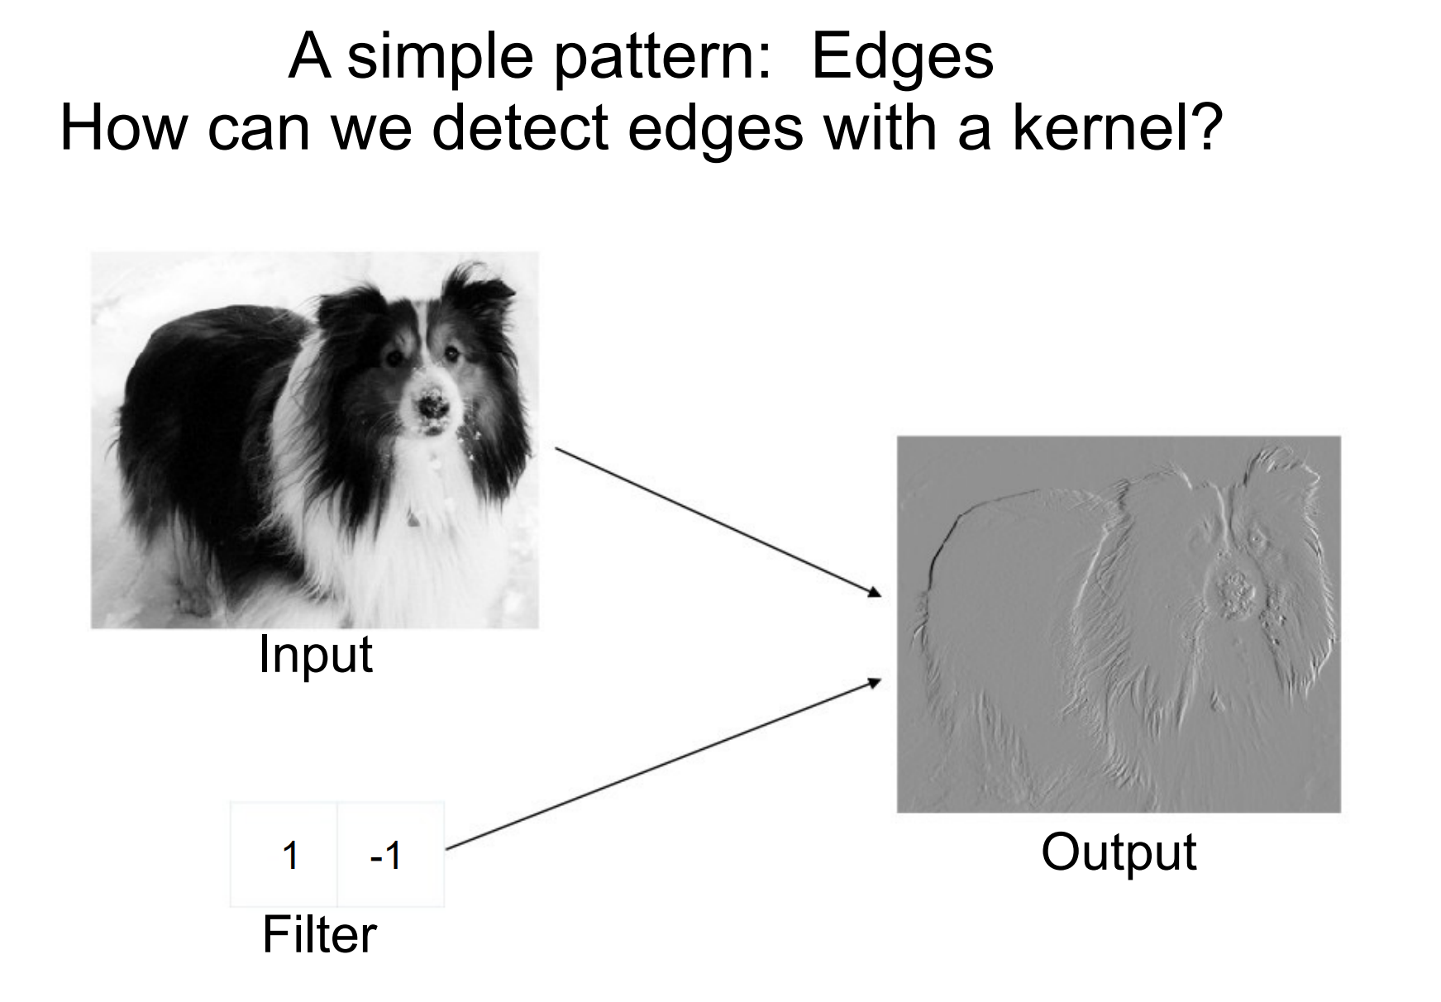

Slide 28
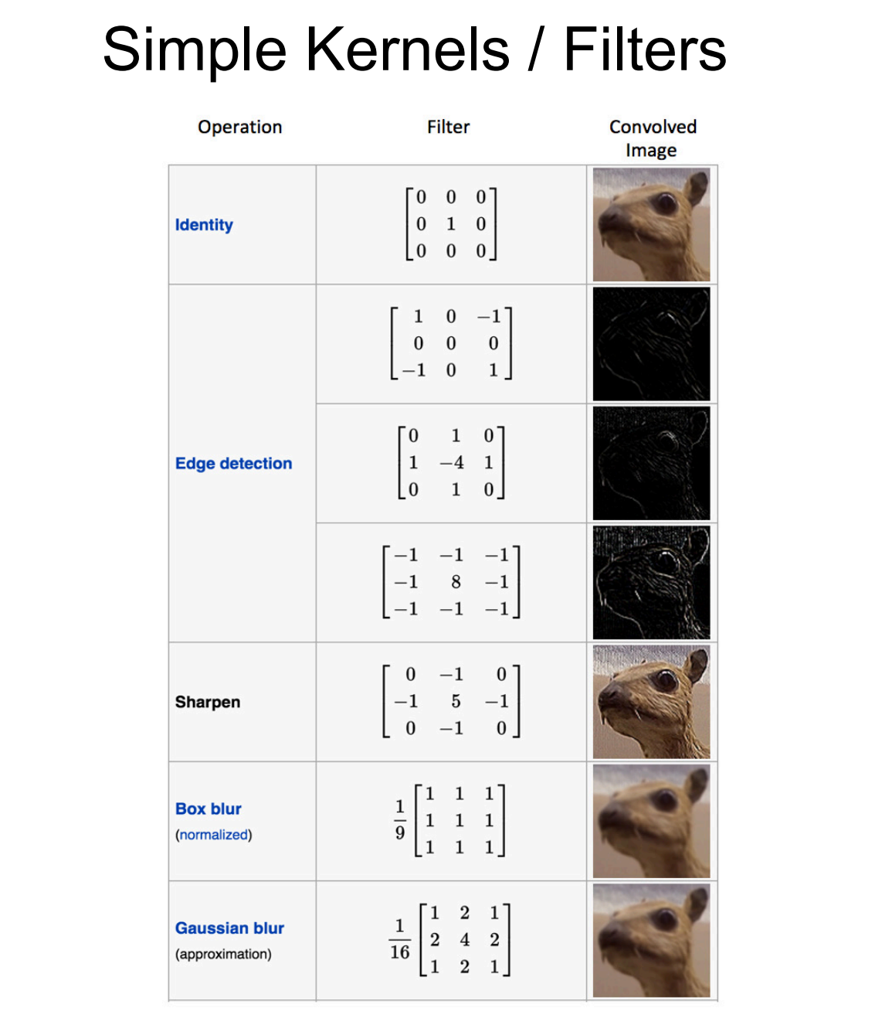

Slide 29
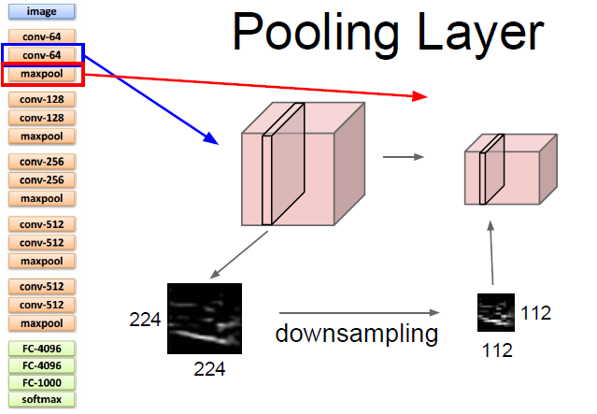

Slide 30
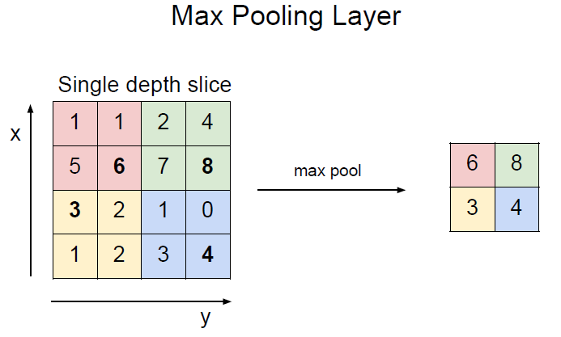

Slide 31
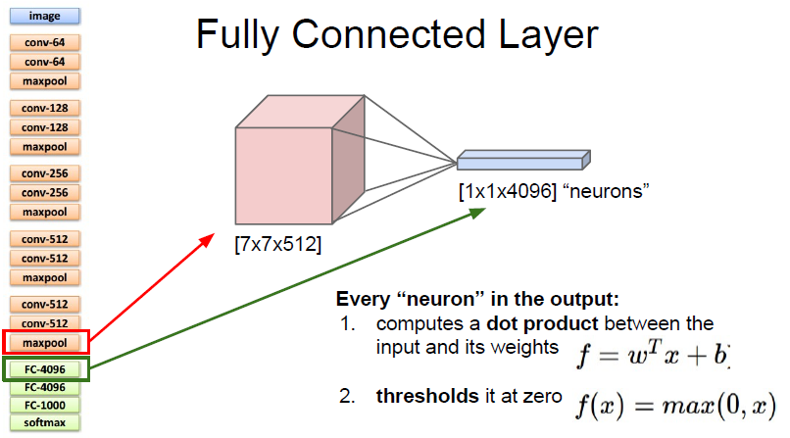

Slide 32
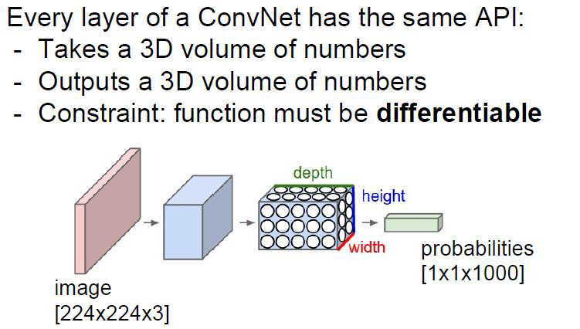

Slide 33
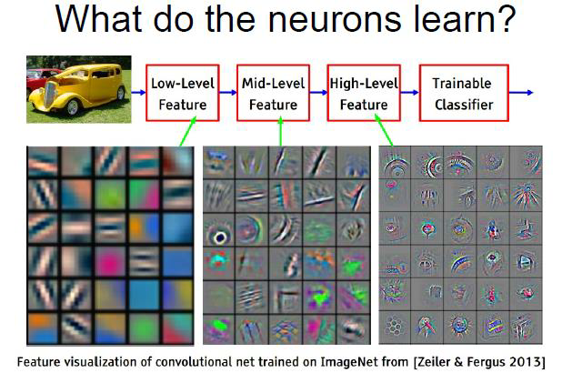

Slide 34
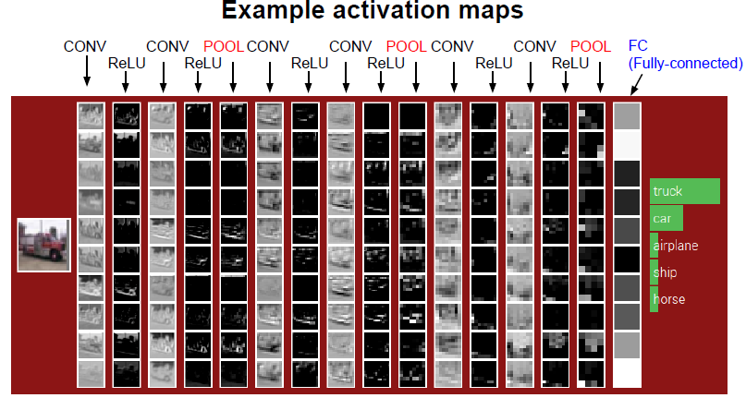

Slide 35
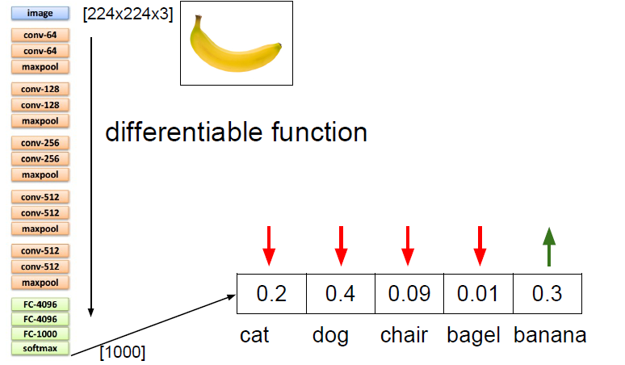

Slide 36
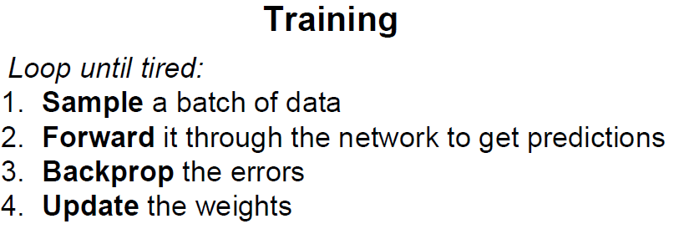

Slide 37
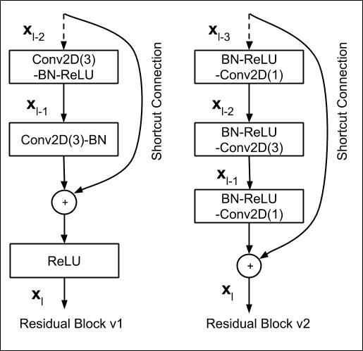
ResNet
CNN + Skip Connections
Pyramidal cells in cortex

Slide 38
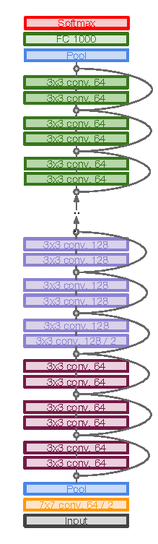
Full ResNetarchitecture:
•Stack residual blocks
•Every residual block has two 3x3 conv layers
•Periodically, double # of filters and
downsamplespatially using stride 2 (in each
dimension)
•Additional conv layer at the beginning
•No FC layers at the end (only FC 1000 to
output classes)

Slide 39
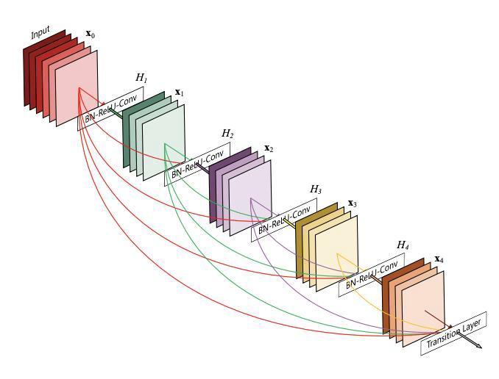
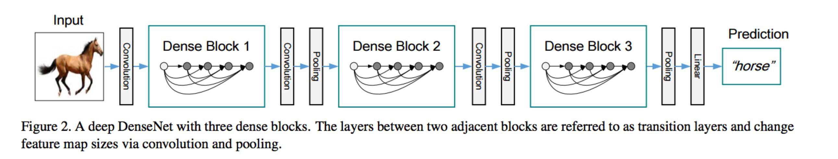
Densenet

Slide 40
Types of Deep Architectures
•RNN, LSTM (sequence learning)
•Stacked Autoencoders(representation learning)
•GAN (classification, distribution learning)
•Combining architectures –unified backpropif all layers differentiable
•Tensorflow, PyTorch

Slide 41
Sequential Modelling

Slide 42
RNNs

Slide 43
Attention

Slide 44
LSTM

Slide 45
Auto Encoders

Slide 46
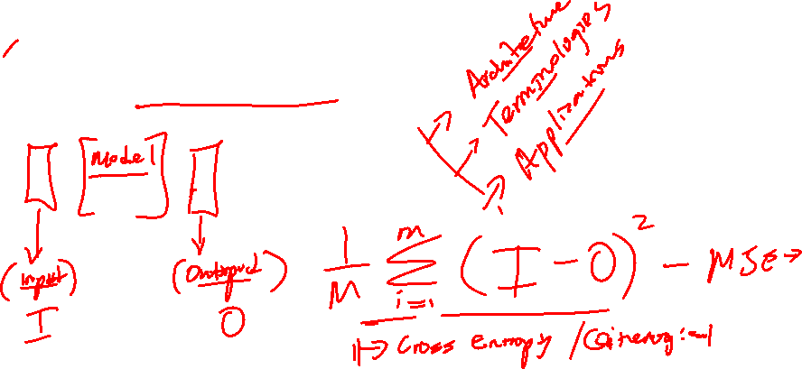
What are Auto Encoders
Auto = self Encoding = Change into a simpler form

Slide 47
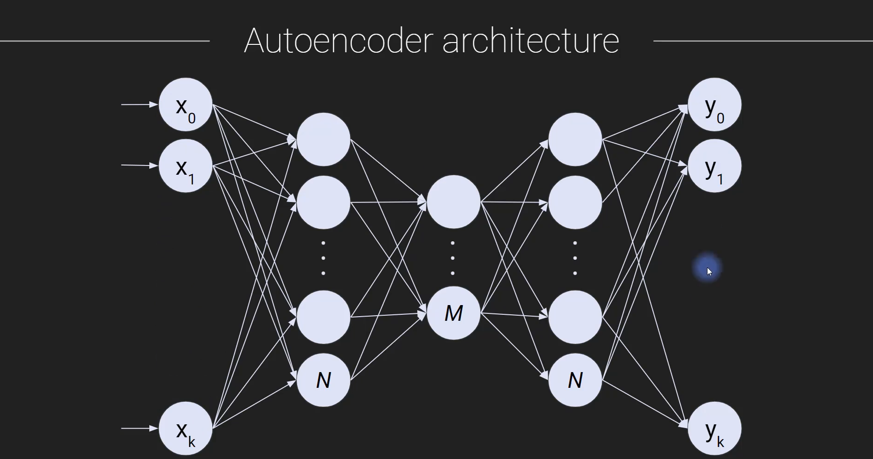
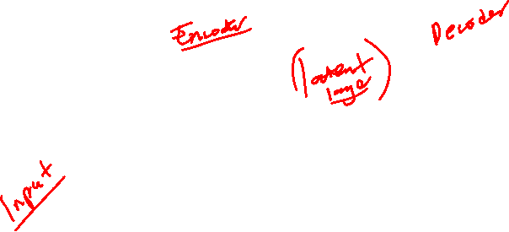

Slide 48
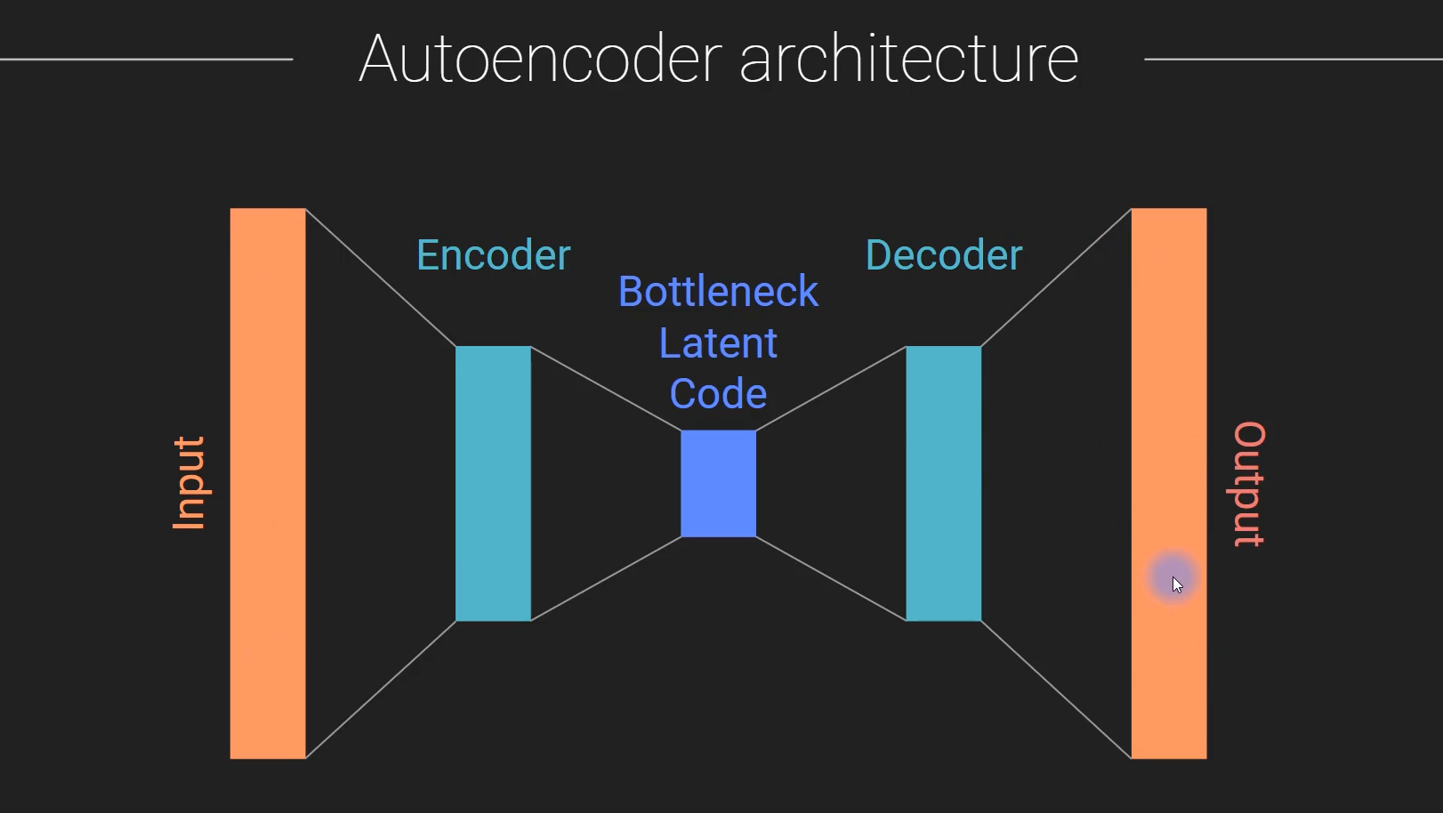

Slide 49
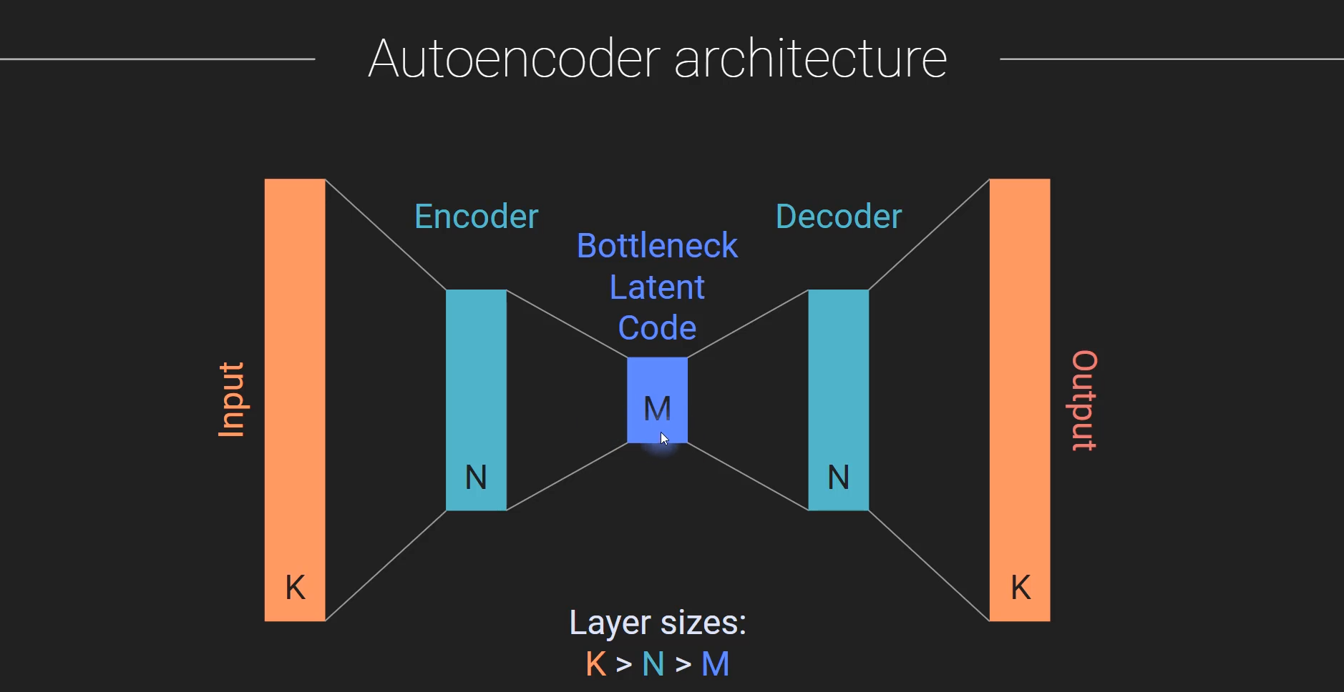

Slide 50
Applications of Auto Encoders
Data compression or dimension-reduction
Data cleaning (denoising, de-speckling, occlusion)
Feature extraction
Anomaly/fraud detection
Pretraining deep or complex models
Autoencoders in Recommendation Systems

Slide 51
GANS

Slide 52
What are Auto Encoders
Auto = self Encoding = Change into a simpler form

Slide 53
Pre-Trained Models

Slide 54
End…

